Slide 1
Class 7

Slide 2
Sports and race
Discourses
Race as a discourse
Racism: prejudice + discrimination
Definition of “race”
What do geneticist explain about “race”?
Are some “races” are better suited for sports?

Slide 3
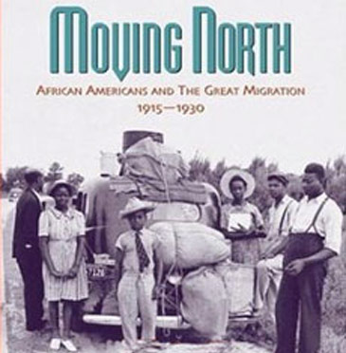
Why did pools became segregated since the 1930s?
Three reasons:
From class division to racial divisions.
  “The Great Migration” – 1.3 Million African Americans moved to the north.
  European migration diminished.
  From sanitation to leisure.
2. integration and “erotization”.
  White women needed to be protected from black men.
  Avoid white women-black male relationships
3. Masculine rivalry.
1. White clerical workers versus black working class workers.

Slide 4
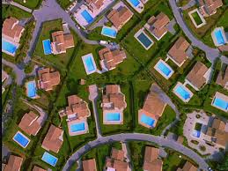
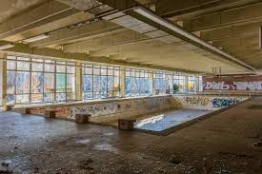
Public pools became desegregated after 1950s, but…

Slide 5
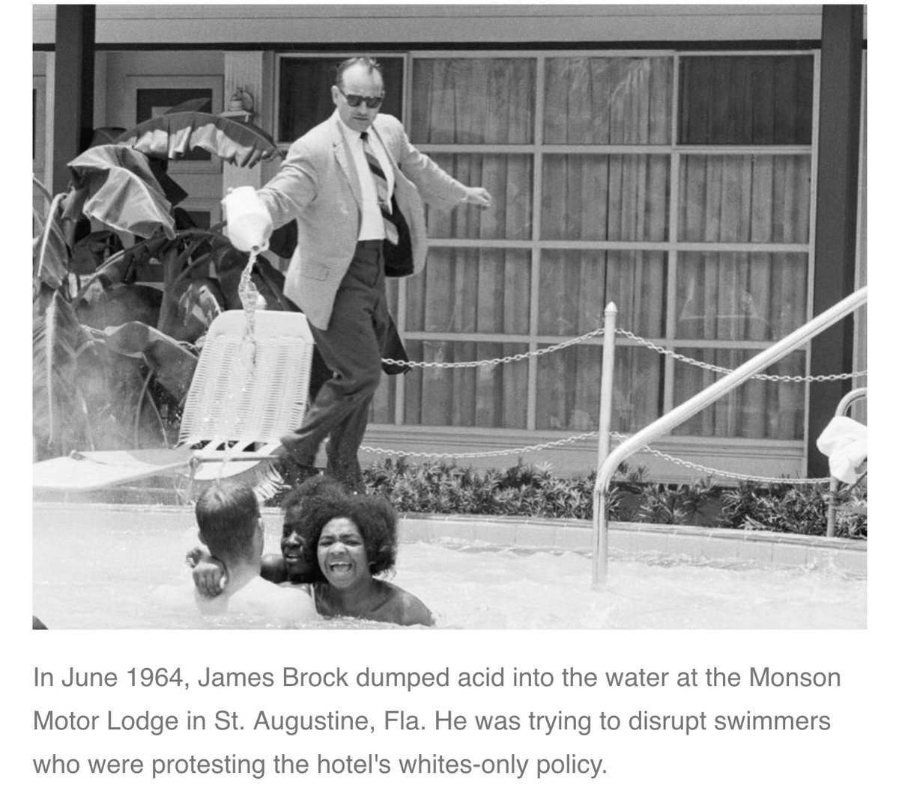
To segregation - 1964

Slide 6
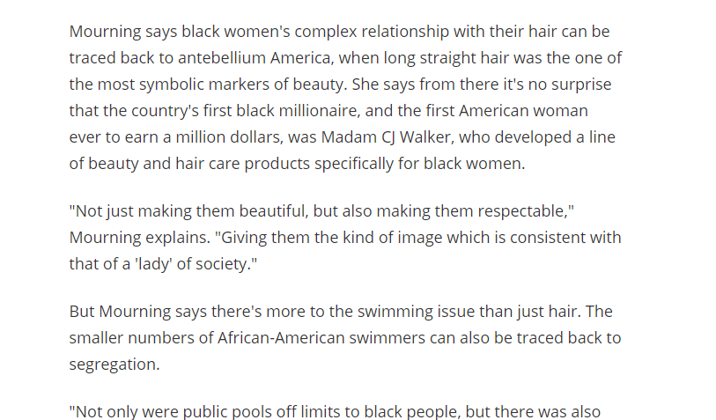
Black women, chlorine and pools
Straight hair as an standard of beauty.
https://www.wqxr.org/story/88529-why-many-black-women-wont-go-swimming/

Slide 7
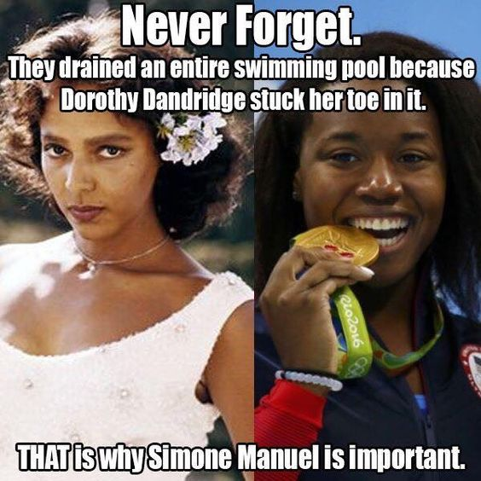

Simone Manuel!!

Slide 8
Swim lessons help minority children break cycle.
https://edition.cnn.com/2012/05/10/us/cnnheroes-butts-josh-project/index.html

Slide 9


Slide 10
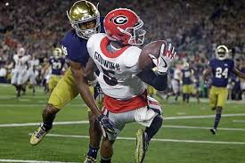
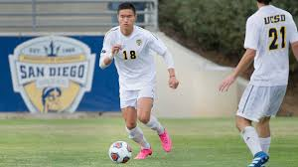
College sports in USA
16 BILLION dollar industry
NCAA has a monopoly over the “industry”
Very complex issue
Are we talking about the same situation?

Slide 11
John Oliver’s Video
Questions
Is NCAA’s D1 a good or bad business? Explain
Why is this idea of a amateurship in D1 polemical?
What are the challenges college athletes endure in their education?
What is happening to the athletes in case of injury?

Slide 13
Criticisms/ Branch’s The Shame of College Sports
Free labor – specially for basketball and football.
Many make millions, while students scholarships.
A few schools make money, many others loose money.
Student-athletes are not university employers.
Athletes over academics
One year renewable scholarship – depends on coaches’ opinions (1973).
Coaches makes million of dollars.
Private companies control universities – TV.
Punishments for “powerless scapegoats”.
Punishment for those who try to
Powerless “kids”

Slide 14
Supporters “No, College don’t exploit their athletes”.
Jim Delany is commissioner of the Big Ten Conference and Andrea Williams heads the Big Sky Conference
Free education – scholarships!
  150,000 student-athletes sponsored in division I and II (NCAA).
Learning through sports.
(But, is there any difference between football/basketball and other sports?)

Slide 15
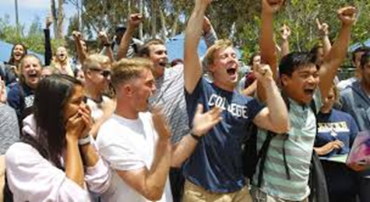
UCSD and Sports
Yes
https://www.youtube.com/watch?v=PFKsGizVSG4
“extend a culture of excellence & positive affect to every (…) Triton”
“improves UCSD’s branding”
“developing prestige & national ratings (…) social life”
No
UCSD has failed to recognize its own sport clubs
40% of the students would need to pay almost a 1000 dollars more in fees
No more tuition increases!
This would create more unnecessary administrative positions.
Did you participate in this referendum? What is you opinion about moving UCSD to D1?

Slide 16
“the chief business of the American people is business” (Coolidge – 1923-1929)
Is ethical to deprive students to make profit on their work?

Slide 17

Historical context
- Ivy League College – 8 schools Harvard University, Yale, Princeton, Dartmouth (Calvinists), Brown (Baptists), U Penn (Methodists), Cornell
Sports promoted those schools – to attract students!
1862 Morrill Land Grant – using federal land to build agricultural schools.
Now, more schools to compete for students!

Slide 18
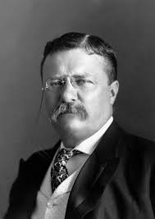
Teddy Roosevelt
1905 18 deaths and 100 injured playing college football
National Collegiate Athletic Association (1920)
G.I Bill (1944)
1960s segregation ended – recruiting black athletes.
TV increased revenues
March Madness

Slide 19
Class exercise/ The Shame of College Sports
1.

Slide 20
Class Exercise
Each group needs to write two FORMAL statements, based on concepts from Lanter and Hawkins’ article (Black Male Bodies and Intercollegiate Athletics, Academic Welfare of College Athletes, Educational Opportunities of College Athletes)
  supporting the UCSD moved into NCAA D1 (provide three reasons)
  rejecting the UCSD’s moved (provide three reasons)
  Find EVIDENCE that support your claims from external sources (legitimate academic or journalist sources).
  Each group pick one of these arguments and read it to the class. Be ready to defend your position.

